Slide 1

Medical Sales Database COVID-19
---- Gaurav singh
Managing Essential Medical Products to Meet Pandemic Demand
The COVID-19 pandemic created a surplus demand for medical products like masks, sanitizers, and ventilators. This project presents a database designed to track the sale and distribution of these products. This database helps ensure that high-demand medical supplies are efficiently managed, stocked, and delivered to the places that need them most, like hospitals, pharmacies, and healthcare clinics.

Slide 2
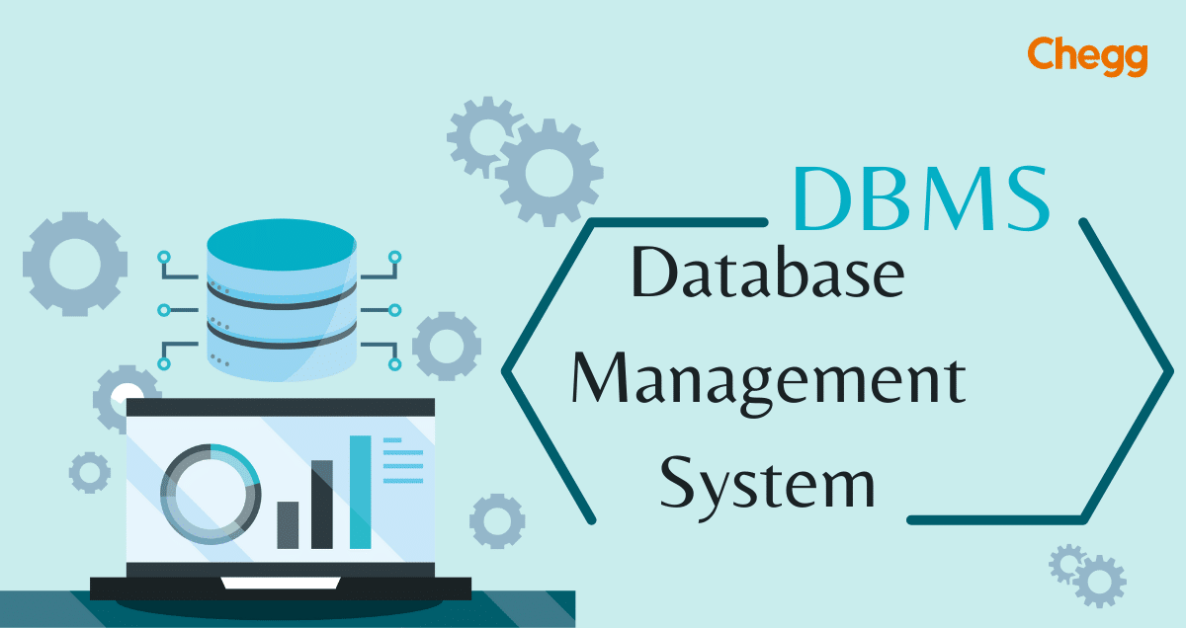
Purpose of the Database
---- Gaurav singh
Efficient Inventory Management
Enhanced Supplier and Customer Management
Detailed Sales Records Key Benefits
Reliability
Flexibility
Accuracy
"Enabling quick responses to rising demand and product shortages."

Slide 3

Database Structure Overview
This database is organized into five key tables, each with a specific role:
Products Table: Contains details for each medical product (e.g., name, type, stock level).
Suppliers Table: Tracks information on companies supplying these products, like contact details and types of supplies.
Customers Table: Lists the buyers of these products, including details of hospitals, pharmacies, and other healthcare facilities.
Sales Transactions Table: Records every sale, capturing essential data like transaction dates and amounts.
Transaction Details Table: Shows each product sold in a transaction, giving us a detailed view of quantities and individual item sales.
"A powerful structure to keep every sale and supply organized!"

Slide 4
Products Table
The Products Table captures data essential for managing each product:
Product ID:
ProductName:
Product Type:
Unit Price:
Stock:
Importance in COVID-19 Context:
"Real-time visibility on every item in stock."

Slide 5

Suppliers Table
The Suppliers Table enables us to manage relationships with companies that supply the products:
Supplier ID:
Supplier Name:
Contact Person
Contact Phone and Email:
Address.
Supply chain disruptions were common, so having up-to-date supplier contacts helped us quickly reach out for restocks and updates on delivery schedules.
"Efficient restocking with accurate supplier contacts."

Slide 6

Customers Table
The Customers Table holds data for each customer that purchases our products:
Customer ID:
Customer Name:
Customer Type:
Contact Phone and Email:
Address:
Hospitals and healthcare providers were key customers needing immediate access to products. Having customer data organized helps respond to their needs more efficiently.

Slide 7

Sales Transactions Table
The Sales Transactions Table stores each completed sale, with key information:
Transaction ID:.
Transaction Date:
Customer ID:.
Total Amount:.
By analyzing transaction data, we can see purchasing trends, identify peak demand periods, and understand customer buying patterns, which are valuable for planning inventory.
"Revenue tracking and trend analysis at your fingertips."

Slide 8

Transaction Details Table
The Transaction Details Table captures the specifics of each sale:
Detail ID:
Transaction ID:
Product ID:
Quantity:
Price:
Helps identify high-demand products within each sale, allowing us to adjust stock levels accordingly and prioritize essential products.

Slide 9
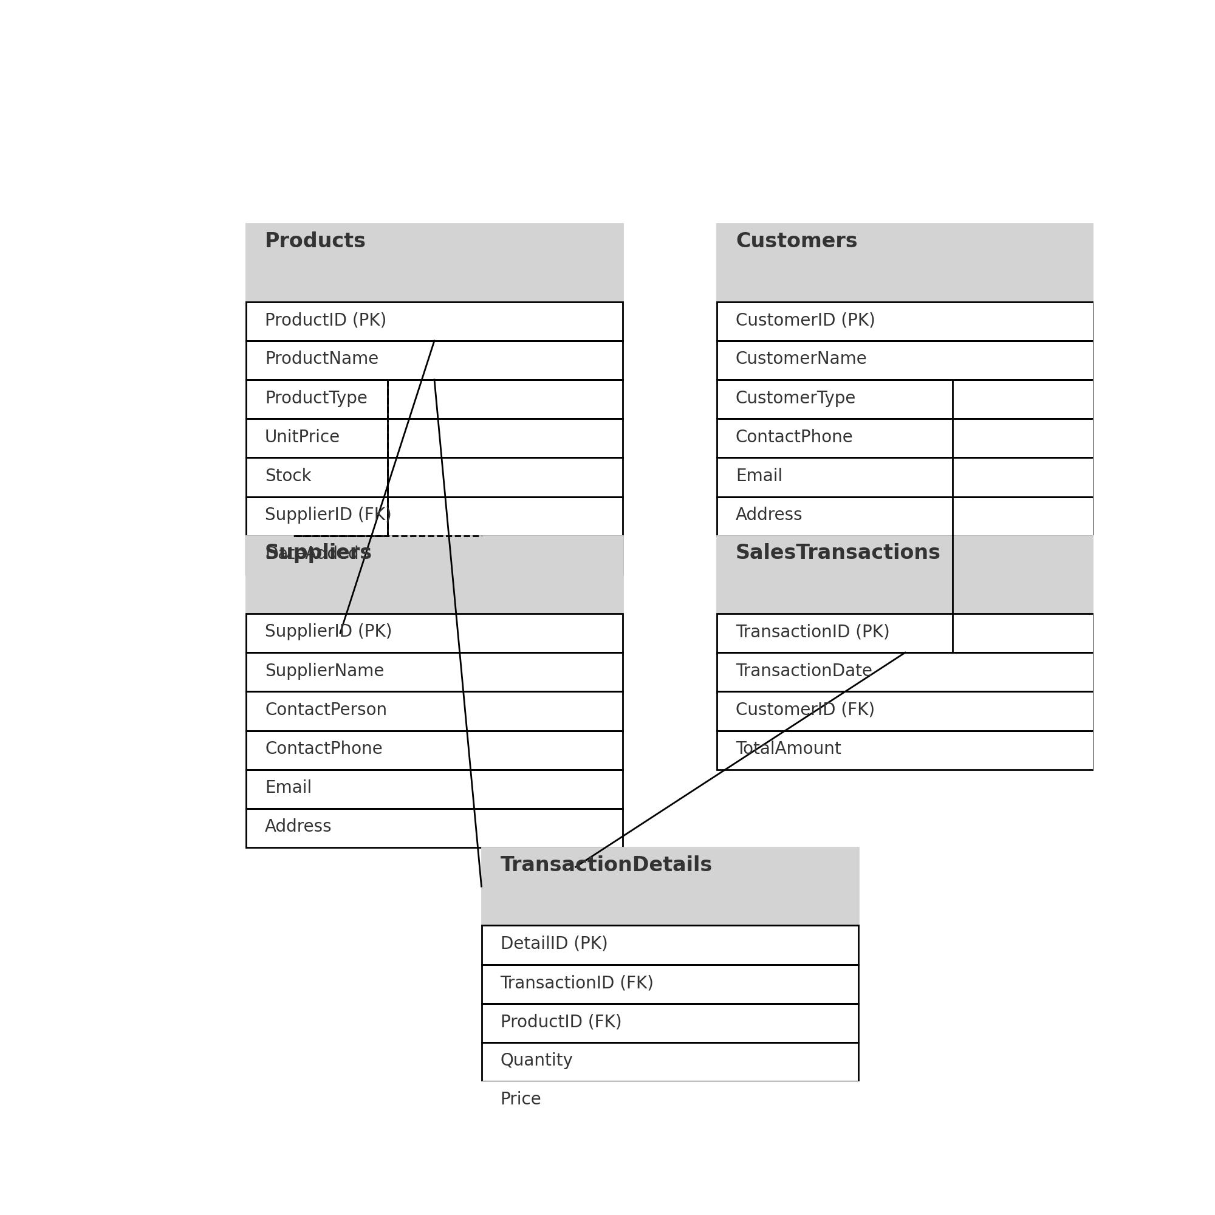
Database Relationships Diagram
Illustrates the relationships between the five tables:
Products to Suppliers: Each product has a supplier for easy restocking.
Sales Transactions to Customers: Every transaction links back to the customer.
Transaction Details to Products and Sales Transactions: Connects each sale with specific items sold.
"Every piece connected—efficient data access."

Slide 10
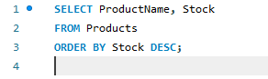
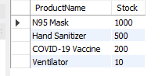
Checking Current Product Stock Levels
Explanation:
Lists each product's current stock in descending order.
Helps identify products with the highest and lowest stock levels.
Insights:
Essential for inventory management and restocking decisions

Slide 11
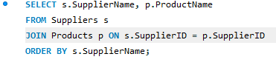
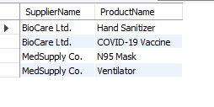
Listing Products by Supplier
Explanation:
Joins Suppliers and Products to see which suppliers provide which products.
Sorted by supplier name.
Insights:
Useful for managing supplier relationships and identifying primary suppliers for critical products.

Slide 12
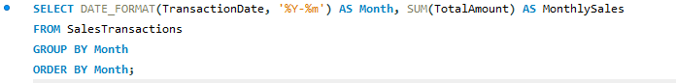
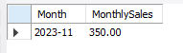
Calculating Monthly Sales Totals
Explanation:
Groups transactions by month to get total sales for each month.
Uses DATE_FORMAT to extract the month and year.
Insights:
Helps in tracking sales trends over time.
Useful for identifying high and low sales months.

Slide 13
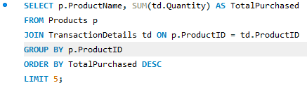
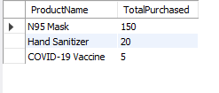
Finding the Most Purchased Products
Explanation:
Joins Products with Transaction Details to get the quantity sold for each product.
Orders by total quantity to find the most popular products.
Insights:
Highlights which products are in high demand.
Useful for prioritizing stock of popular items.

Slide 14
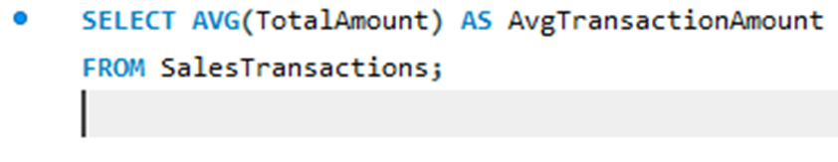
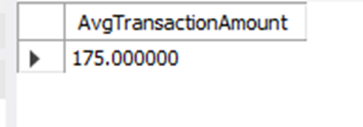
Calculating Average Sales Amount for Each Transaction
Explanation:
•Calculates the average value of each transaction from the Sales Transactions table.
Insights:
•Useful for understanding the average spending per sale.
•Helps in setting sales targets and monitoring transaction values over time.

Slide 15
Conclusion and Key Take aways
Insightful Data Analysis:
Inventory Management:
Customer and Supplier Relations:
Sales Performance:.
This analysis underscores the power of SQL in managing and extracting actionable insights from complex databases, especially in dynamic fields like medical supplies during COVID-19.

Slide 16

---- Gaurav singh

